Slide 1
Canada during the 1920’s
Roaring 20’s
Adapted from Creating Canada, McGraw-Hill, 2014. Chapter 7 & 8.
Ms. Grace

Slide 2
End of WWI
Nearly 600 000 men & women had served in the Canadian forces during WWI
By the end, between 60,000-70,000 Canadians never returned.
More than 172 000 were wounded (physically and mentally)
The allies had won the war, but it was costly
Canada was in debt, and entering turbulent time.
In the decades ahead Canada faced rapid changes marked by periods of boom and bust.

Slide 3
Changing Expectations
When veterans returned from Europe they were hero’s.
During the war, supplying materials had been good for Canadian businesses & helped to create plenty of well paying jobs
When the veterans returned, there weren’t enough jobs.
Women were expected to give up their jobs for the returning male veterans.
Ex. Munitions employed up to 300 000 ppl during the war, this was no longer needed afterwards.
At the end of 1921, 20 percent of veterans were unemployed.
Made worse by increasing immigration of Europeans (primarily British)

Slide 4
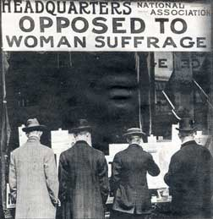
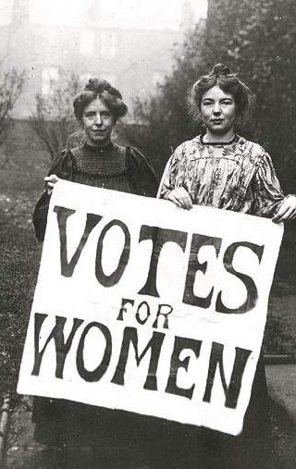
Women’s Rights
Canadian women began to campaign for suffrage – the right to vote.
Ontario was the first province to allow SOME women to vote: widows and unmarried women who owned property could vote in municipal elections
By 1918 SOME women won the right to vote in provincial and federal elections in Manitoba, Alberta, Saskatchewan, British Columbia, Ontario and Nova Scotia: all WHITE women BORN IN CANADA.
In 1919 women’s right to run for Parliament was recognized.

Slide 5
Conditions in Canada
Economy was in chaos – largely because of unemployment and closing of large munitions factories, chemical and steel plans, and mining operations.
Food and fuel were in short supply and became more expensive.
In 1914 ground beef was 10 cents, by 1918 it was 39 cents (increase of 300% in just 4 years – wages did not increase, they decreased).
During the war years employers needed workers. Fewer workers than jobs (supply/demand). Employers frequently had to pay higher wages to keep /hire workers
After the war, they had too many workers and fewer jobs. Workers were ‘a dime a dozen’. Workers had no leverage to bargain for better wages.

Slide 6
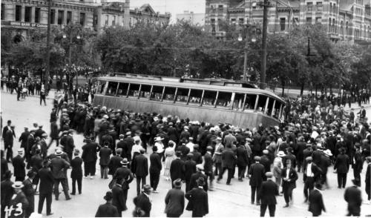
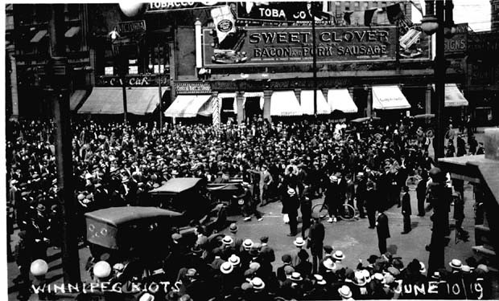
Labour Unrest
Growth of labour unions – workers wanted improved wages, and reasonable work hours (i.e. 8 hour days).
Unions got together and formed One Big Union (OBU), to collective bargain together (more bargaining power).
Supported general strikes – not directed against a single employer, rather, directed against government and employers as a group.
Winnipeg General Strike, 1919.
94 unions walked off the job 20 000- 30 000 ppl.
The strike closed factories, stores, public transportation, fire fighters, postal workers, and even police.

Slide 7
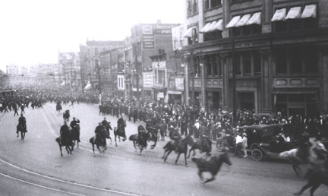
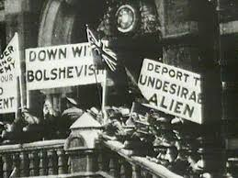
Labour Unrest Cont’d
A committee of business owners, politicans, and bankers tried to portray the strike as an effort by foreigners to overthrow the democratically elected Canadian government (an insight into racism already present in society).
Hired 1800 special police officers and the army to move in on the protestors.
Threatened with losing their jobs, the strikers returned to work six weeks after the strike began.

Slide 8
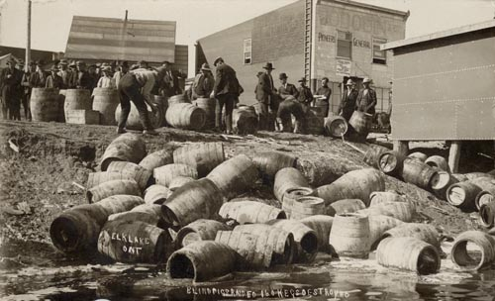
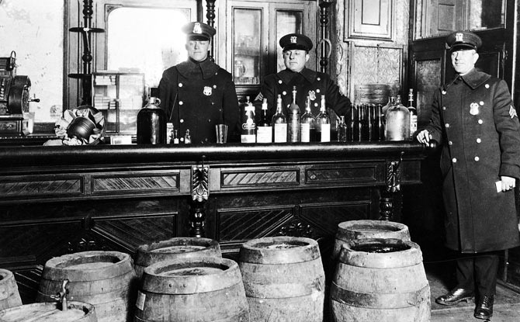
Prohibition
Alcohol was blamed for many social problems, such as crime, public drunkenness, family violence, and poverty
Temperance movement called on people to abstain from drinking alcohol
In 1918, under the War Measures Act, the federal government enacted Prohibition – laws against making and selling liquor.
The ban lasted until a year after the war ended.

Slide 9
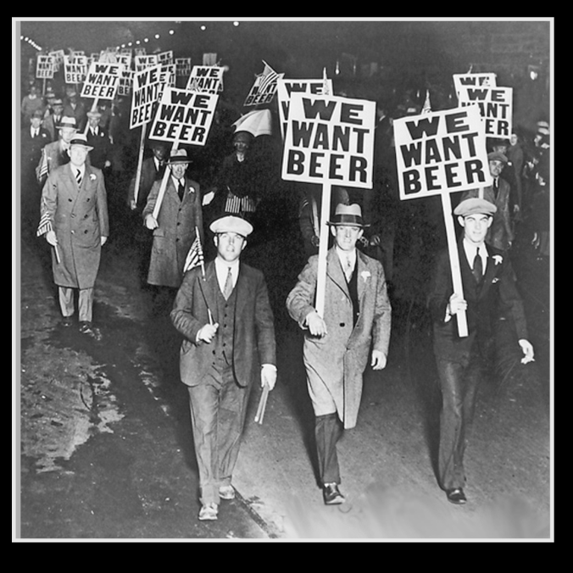
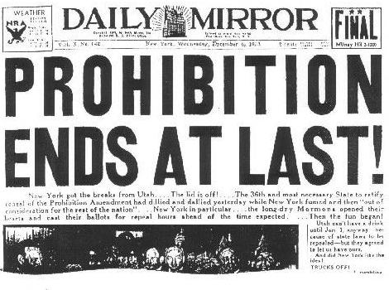
Prohibition cont’d
Illegal trade in alcohol developed – people had to buy from criminals for high prices
Governments lost the income generated from alcohol taxes
US Prohibition laws remained in effect well after Canadian, which created profitable business opportunities for Canadian liquor companies (‘looked the other’ way when their products were smuggled into US)
“rum runners” transported 45 million litres of liquor into the US each year

Slide 11
A Growing Economy
Industries developed mass production techniques during the 1920’s
Using assembly lines, products could be turned out more quickly and for less money (lowered cost of production, meant lower cost for consumers)
By 1927 Ford Motor Co., had sold 15 million Model T’s globally
Vehicle ownership in Canada jumped from 300,000 (1918) to 1.9 million (1929)
Rapid increase in cars encouraged government to invest in infrastructure (roads, bridges, power systems, etc… = jobs!)
During the 1920’s electrical energy production in Canada increase 400%
Canadian resource industries (forestry, mining) expanded to keep up with demand for materials.
Pulp and paper industry grew rapidly
Canada became a major wheat exporter. Growing 250% since WWI

Slide 12
Changing Trade Partners
Until the 1920s, Britain was Canada’s main trading partner
As the American economy became stronger, trade between Canada and the US grew, while trade between Canada and Britain declined.
By 1925, the US had become Canada’s biggest trade partner.
The Canadian economy benefitted from the strong US economy.
US needed our natural resources to manufacture products (ex. Newspapers).
Branch plants began – American companies with branch plants in Canada (this helped them avoid trade tariffs).
People were torn – on one hand it created jobs for Canadians, but on the other, it took away from competing Canadian business.

Slide 13
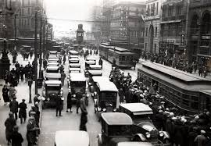
Urbanization
Manufacturers built their plants in urban areas because they needed large, skilled labour force and transportation links.
Canadian cities began to grow as workers crowded into them.
Growth of cities was increased by technological innovations (streetcar and road systems)
Telephone and telegraph communications
Canadians became less self-sufficient; relied on clothing stores, housing, education, health care, etc.

Slide 15
Consumerism
During the boom of the 1920’s more Canadians could afford to buy consumer goods.
Many had money left over after paying expenses
Mass advertising campaigns began (encouraged people to spend)
Department stores like T. Eaton Co. created catalogues and mailed them across the country
The use of consumer credit (borrowed money) became more common (furnishings, cars, etc)
People began buying expensive items on instalment plans
The amount of household debt increased dramatically
Credit was also available for playing the stock market, and this appealed to people who wanted to share in the promise of huge profits.
Paying very little up front, even average citizens could invest, and the stock market boomed (setting new records)

Slide 16
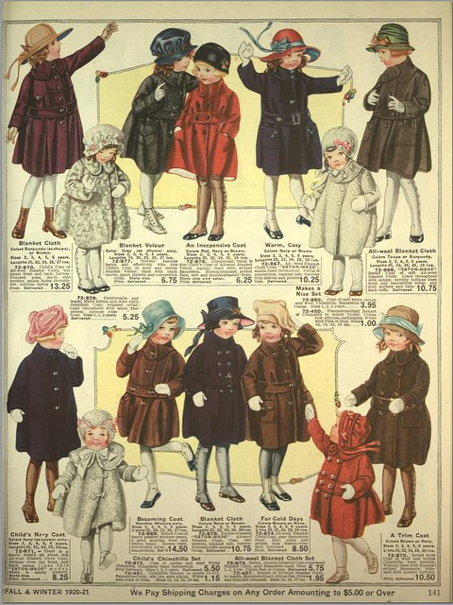

Slide 17
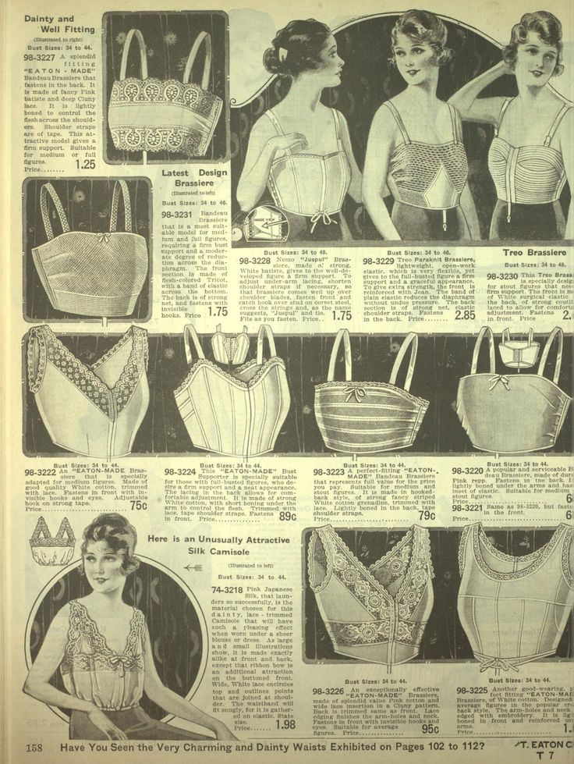

Slide 18
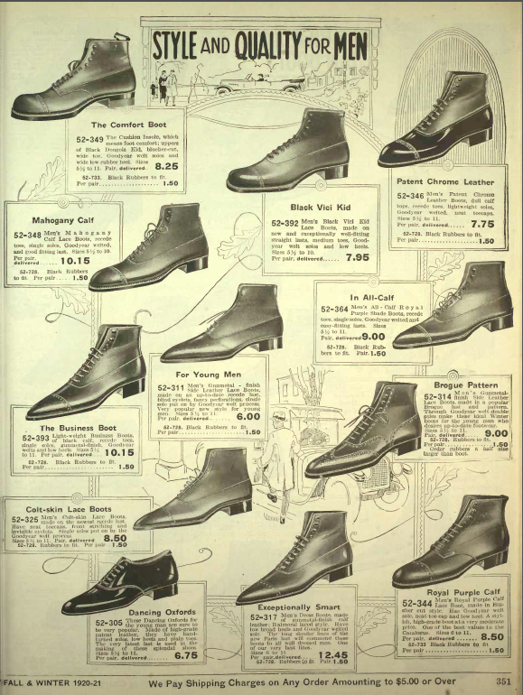

Slide 19
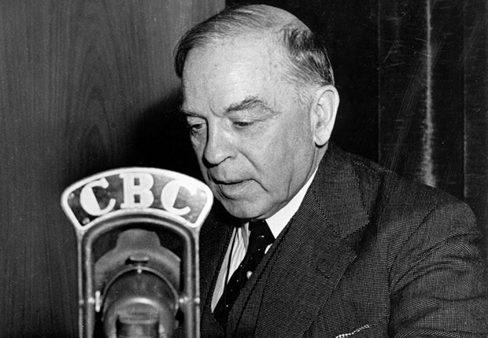
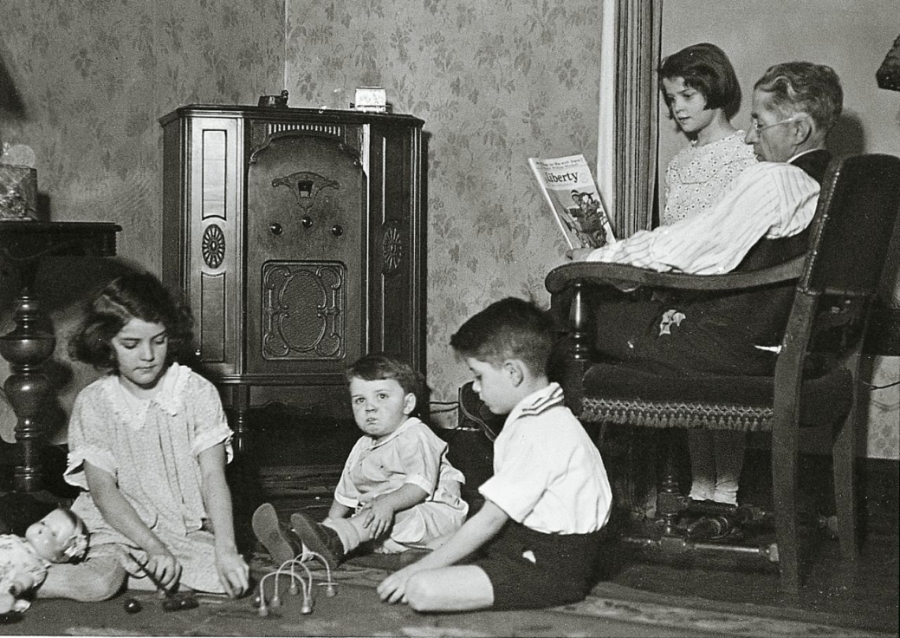
Rise of the Radio
During the 1920’s more people bought radios as the technology improved and prices fell.
By 1928, some Canadian radio stations existed, but 80% of the programs Canadians listened to were from the US.
Drama, comedy shows, music, and sports broadcasts.
Prime Minister William Lyon Mackenzie King participated in Canada’s first cross-country radio broadcast in 1927.
He continued to use radio to address the country.

Slide 20
Changes in Science & Technology
Roads
In 1919 Parliament passed the Canadian Highways Act, committing to the federal gov’t to build 40,000km of highway
By 1930 the annual cost of building roads was about $94 million.
Made average Canadians mobile
Communication
In 1927 13/100 Canadians had a telephone.
Medicine
Began treating diabetes
Tuberculosis vaccination (was the leading cause of death for Canadians 20-50 yrs old)

Slide 21
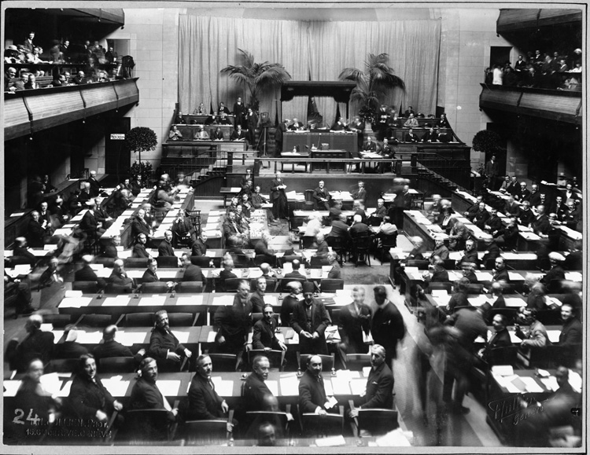
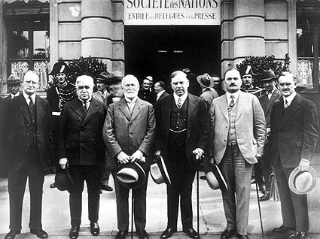
Growing Autonomy
Many Canadians also wanted greater autonomy (independence) from Britain.
They believed Canada should no longer be tied to the European power.
The country took steps toward independence
The Balfour Report (1931) – Britain could no longer make laws for its former colonies
Canada joined the League of Nations – took independent action in cooperation with other countries

